Slide 1
UNDERSTAND PLANNING AND MANAGEMENT OF COSTS

Slide 2
Agenda
Options for purchasing Azure products and services
Options around Azure free account
Factors affecting costs
Zones
THE PRICING CALCULATOR
The total cost of ownership (TCO) calculator
Best practices for minimizing Azure costs
Azure Cost Management

Slide 3
Options for purchasing Azure products and services
There are a couple of ways to purchase Azure products and services. You can purchase products and services directly from Microsoft, or you can purchase through a Microsoft Cloud Solution Partner (CSP).
When you purchase directly from Microsoft:
you decide which Azure services you want to purchase, and
you manage all of your deployments and usage of those services.
Each month Microsoft will invoice you for your Azure usage, and you’ll have access to those invoices in the Azure portal
If you need support for your Azure resources, you get support directly from Microsoft using one of the available support plans for Azure
Purchase directly from Microsoft

Slide 4
Options for purchasing Azure products and services
You have the option to purchase directly from the portal or to have your services added to an existing Enterprise Agreement with Microsoft. Enterprise Agreements are designed for large companies that have a large amount of usage in Azure. When you sign up for an Enterprise Agreement, you work with Microsoft to come up with a yearly financial commitment for Azure usage. You are charged yearly for the committed price, and if you use more than your agreed-upon usage, you are charged for the additional usage at the rate you and Microsoft agree to.
Purchasing directly from Microsoft offers the most flexibility and control because you decide which individual resources you are purchasing. It’s also important to consider that your development team may have experience in developing against specific types of Azure resources, and by controlling the types of resources you use, you can reduce the number of potential problems in your applications
Purchase directly from Microsoft

Slide 5
Options for purchasing Azure products and services
When you purchase from a CSP:
You are not purchasing individual Azure resources. Instead, you are purchasing an entire cloud solution developed by the CSP. When you need to deploy your application, you work with the CSP to manage the deployment.
The CSP also provides you information on usage costs of your resources, and if you need support, you get that support from the CSP, not from Microsoft.
if you have a need to deploy a complex cloud solution and you don’t have on-premises expertise in some areas, a CSP may be the best option for you. Because the CSP is certified to have expertise in the services they offer, they may be able to provide you with a more efficient solution that can help you reduce costs and support needs.
Purchase from a CSP

Slide 6
Agenda
Options for purchasing Azure products and services
Options around Azure free account
Factors affecting costs
Zones
THE PRICING CALCULATOR
The total cost of ownership (TCO) calculator
Best practices for minimizing Azure costs
Azure Cost Management

Slide 7
Options around Azure free account
If you’ve never had an Azure free trial and you’ve never been a paid Azure customer, you are eligible for an Azure free account.
A free account gives you 12 months of free access to the most popular Azure services, and many other Azure services offer free usage even after those 12 months have elapsed.
You also get a $200 credit that you can use for Azure services for a 30-day period after you sign up for a free account
Microsoft places a $200 spending limit on free accounts so that you don’t accidentally go over the $200 free credit. If you hit that spending limit, you will need to upgrade your subscription to a Pay-As-You-Go subscription in order to create additional resources.
At the end of the 30-day period, any resources that are not free for 12 months or more are deleted automatically, so you’ll want to ensure you upgrade your Azure subscription before the 30 days has elapsed if you want to continue using your resources.

Slide 8
Agenda
Options for purchasing Azure products and services
Options around Azure free account
Factors affecting costs
Zones
THE PRICING CALCULATOR
The total cost of ownership (TCO) calculator
Best practices for minimizing Azure costs
Azure Cost Management

Slide 9
Factors affecting costs
The primary factors that impact costs are:
The resource type
How you purchase the resource
The Azure regions you’re using, and
The billing zone your resources are in
Each Azure service has a pricing page that outlines estimates on pricing for that resource based on typical usage.
Azure services are billed according to meters associated with a resource. These meters track how much a specific metric has been used by the resource.
As you determine which resources you need to use in your Azure deployment, consider how those resources are going to use the metrics the resources charges for. For example, if you can plan your virtual networks so that you have fewer peered networks, you can save substantially over the long-term.

Slide 10
Factors affecting costs
Microsoft’s costs for operating Azure services differs by region, even when those regions are within the same geographic boundary. Therefore, your pricing will differ based upon which Azure region you use.
Choosing the least expensive region for each of your Azure resources usually isn’t a good way to control costs. You may end up having to pay for network traffic across regions, and that may increase your costs above the amount you’re saving.
It’s also important to keep in mind that you’re not charged for network traffic into an Azure datacenter, but you are charged for network traffic out of a datacenter. However, your first 5GB of outbound data is free.

Slide 11
Agenda
Options for purchasing Azure products and services
Options around Azure free account
Factors affecting costs
Zones
THE PRICING CALCULATOR
The total cost of ownership (TCO) calculator
Best practices for minimizing Azure costs
Azure Cost Management

Slide 12
ZONES
Azure geographies are broken out into four separate groups for billing purposes. These groups are called billing zones, or more commonly, simply zones.
The cheapest outbound networking costs are in Zone 1. DE Zone 1 is the second cheapest, followed by Zone 2 and Zone 3.
Zone Name | Included Geographies
Zone 1 | United States, Europe, Canada, UK, France
Zone 2 | Asia Pacific, Japan, Australia, India, Korea
Zone 3 | Brazil
DE Zone 1 | Germany

Slide 13
Agenda
Options for purchasing Azure products and services
Options around Azure free account
Factors affecting costs
Zones
THE PRICING CALCULATOR
The total cost of ownership (TCO) calculator
Best practices for minimizing Azure costs
Azure Cost Management

Slide 14
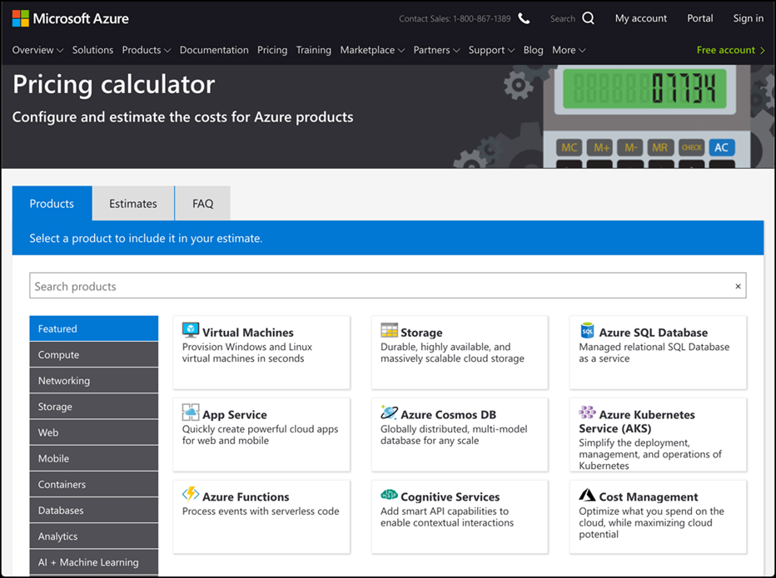
The Pricing Calculator
The Azure pricing calculator can help you get an estimate of expenses based on the products you intend on using, as well as where those products will be deployed, and so on. You can access the pricing calculator by browsing to: https://azure.microsoft.com/en-us/pricing/calculator.

Slide 15
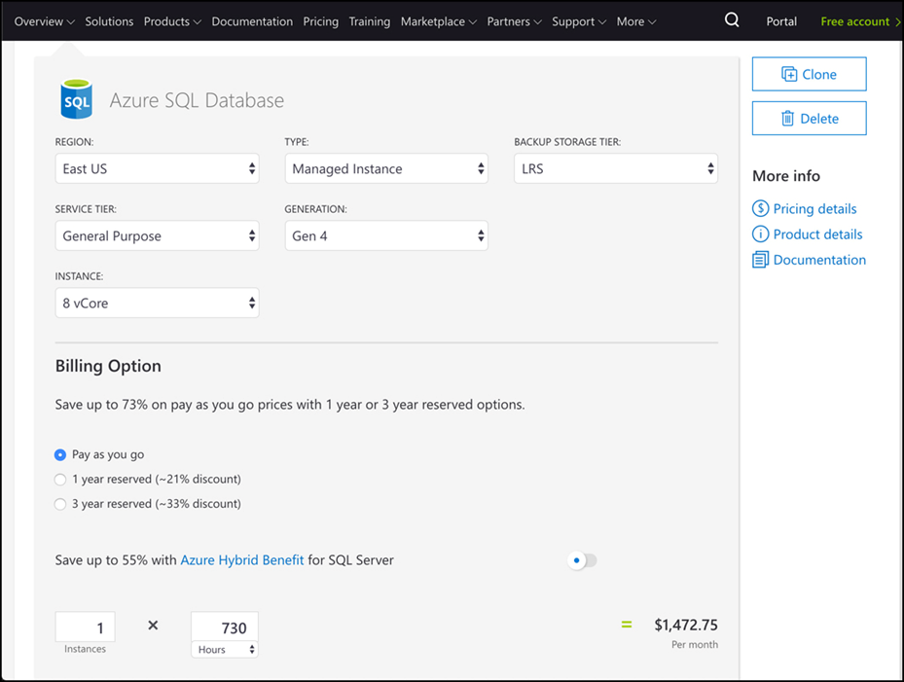
The Pricing Calculator
Select which products you want to use.
If the product you want is not listed, you can either click on a category of products in the list on the left or you can search for your product by entering its name in the search box.
Scroll down to configure the specific details of each service.

Slide 16
The Pricing Calculator
Clicking on Pricing Details will open the pricing page for the product in a new tab. You can also click on Product Details or Documentation to read more about the service in order to help you make better decisions about the options you select.
Once you’ve configured a product based on your needs, you can click the Clone button to add another instance of that product to your estimate.
To review your pricing estimate, scroll to the bottom of the page. You can choose a support plan to add to your estimate. If you have an Enterprise Agreement or Microsoft Customer Agreement, you can choose them in order to have that pricing applied to your estimate.

Slide 17
Agenda
Options for purchasing Azure products and services
Options around Azure free account
Factors affecting costs
Zones
THE PRICING CALCULATOR
The total cost of ownership (TCO) calculator
Best practices for minimizing Azure costs
Azure Cost Management

Slide 18
The total cost of ownership (TCO) calculator
The pricing calculator is helpful for estimating your expenses for new applications in Azure, but if you have on-premises applications you want to migrate to Azure and you want an estimate of how much you can save in Azure, the TCO calculator is a better choice. You can access the TCO calculator by browsing to: https://azure.microsoft.com/en-us/pricing/tco/calculator.

Slide 19
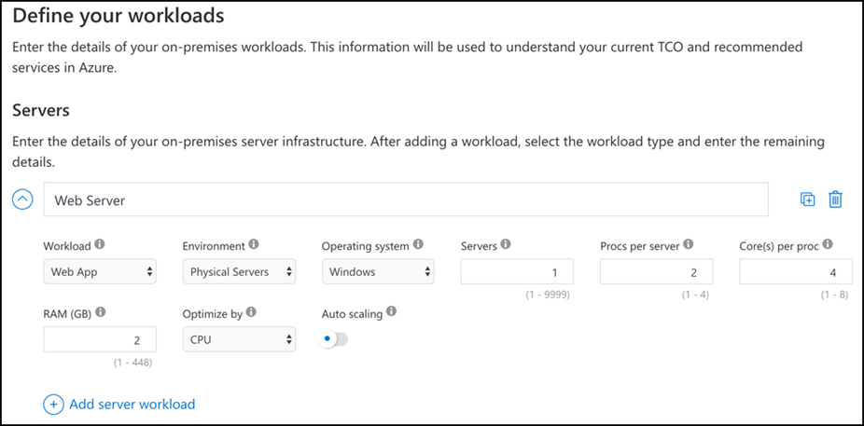
The total cost of ownership (TCO) calculator
The first step when using the TCO calculator is to add details about your on-premises servers, databases, storage, and network usage.
You can configure all of the details about the server, including the OS, whether it’s a VM or a physical server, and more.

Slide 20
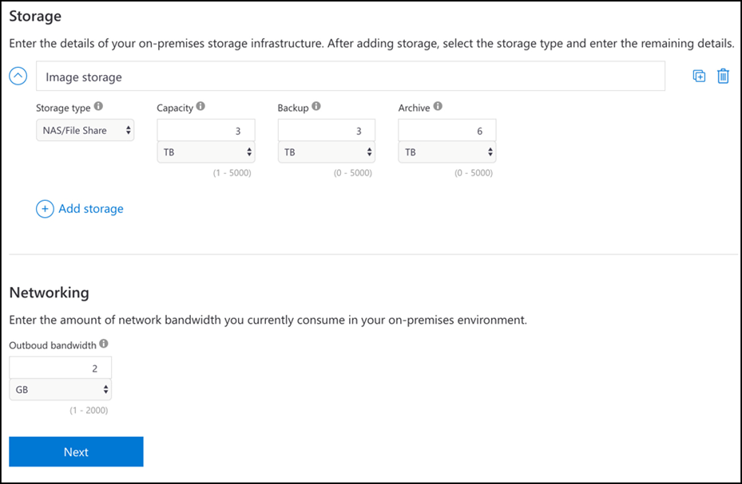
The total cost of ownership (TCO) calculator
Databases and storage systems that are on-premises should also be added, in addition to any network usage for your application.

Slide 21
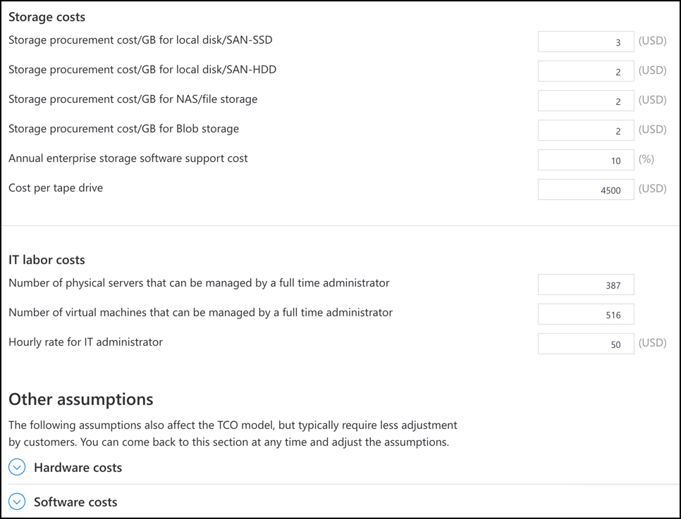
The total cost of ownership (TCO) calculator
After entering all of your on-premises workloads, you can view the assumptions the TCO calculator uses by clicking Next. The TCO calculator uses a comprehensive list of on-premises expense assumptions that Microsoft has put together based on years of experience, and these assumptions are used to provide you with the best estimate possible of your cost savings.
Notes:
For an accurate TCO estimate, it’s best to carefully record your expenses before generating a TCO report.

Slide 22
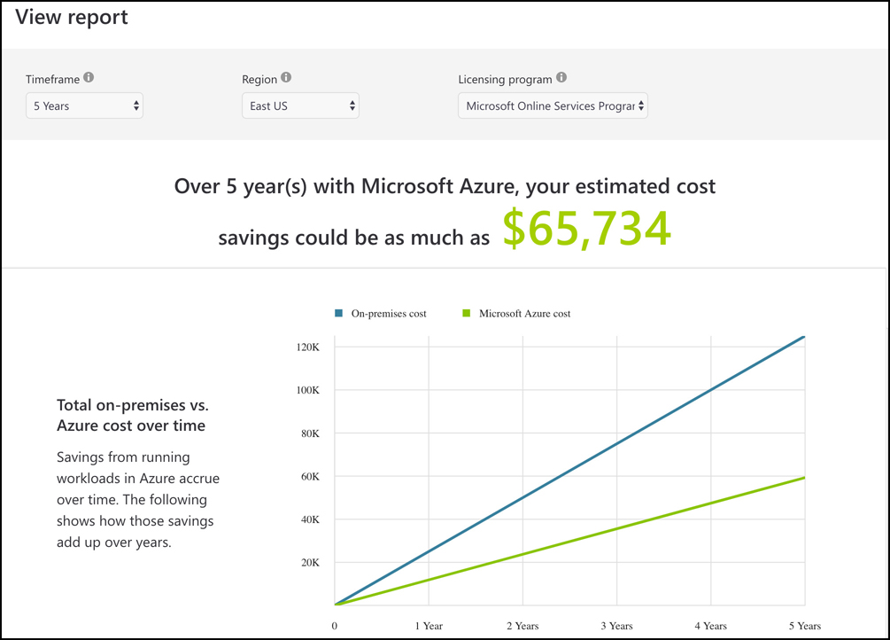
The total cost of ownership (TCO) calculator
After you adjust your assumptions, scroll to the bottom of the screen and click Next to view your TCO report. Your TCO report shows you how much you can save over the next 5 years by moving your app to Azure
Notes:
For an accurate TCO estimate, it’s best to carefully record your expenses before generating a TCO report.

Slide 23
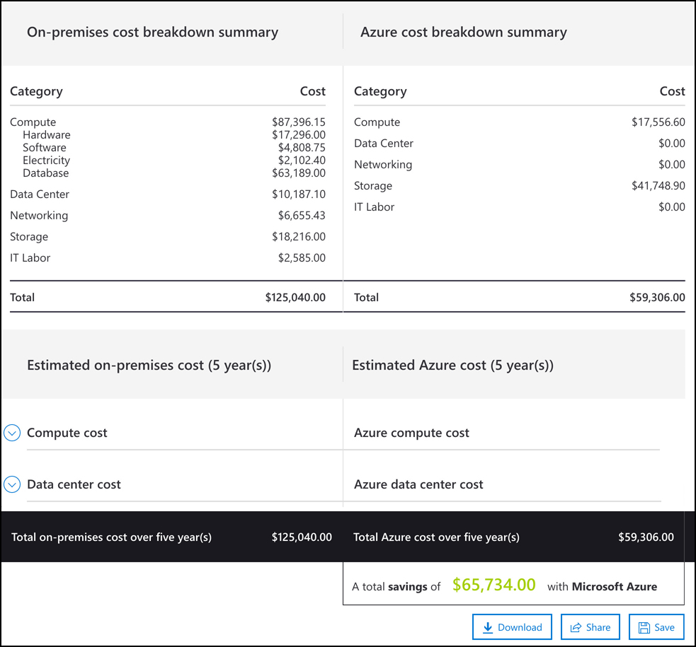
The total cost of ownership (TCO) calculator
A TCO report includes detailed charts of expense savings, and at the bottom of the report, you’ll find a breakdown of on-premises costs and Azure costs so you can easily determine where you’ll save money.
Notes:
For an accurate TCO estimate, it’s best to carefully record your expenses before generating a TCO report.

Slide 24
Agenda
Options for purchasing Azure products and services
Options around Azure free account
Factors affecting costs
Zones
THE PRICING CALCULATOR
The total cost of ownership (TCO) calculator
Best practices for minimizing Azure costs
Azure Cost Management

Slide 25
Best practices for minimizing Azure costs
Minimizing your costs in Azure begins with careful planning before you even create a single Azure resource. Planning needs to involve the key players in your organization such as your finance department, managers who are responsible for budget planning and implementation, and application designers who are in the best position to decide what types of resources are likely needed.
Make sure that, as you analyze your on-premises workloads, you ensure that all of the resources your app is using are actually required by the app.
An important part of minimizing costs in Azure is to ensure that you fully use all of your cloud resources. Because most cloud usage is billed on consumption of a resource, not using portions of a resource represents unnecessary expenses.
As you’re analyzing your on-premises usage and planning your move to Azure, you should take the opportunity to organize your resources based on expense accountability. You can then use that organizational structure in Azure to apply tags to resources so that each organization within your company has proper visibility into their expenses. This will help to ensure that if a resource is being under-utilized, the right people will quickly have visibility into that so adjustments can be made

Slide 26
Best practices for minimizing Azure costs
Once planning is complete, you’ll need to determine which Azure subscription plan is most suitable for your needs.
At this stage in your planning, the pricing calculator and TCO calculator can be helpful in estimating your cloud expenses.
Notes:
For more information on Azure Cost Management, see https://docs.microsoft.com/azure/cost-management.
For more information on best practices for minimizing costs, see: https://docs.microsoft.com/azure/cost-management/cost-mgt-best-practices.

Slide 27
Agenda
Options for purchasing Azure products and services
Options around Azure free account
Factors affecting costs
Zones
THE PRICING CALCULATOR
The total cost of ownership (TCO) calculator
Best practices for minimizing Azure costs
Azure Cost Management

Slide 28
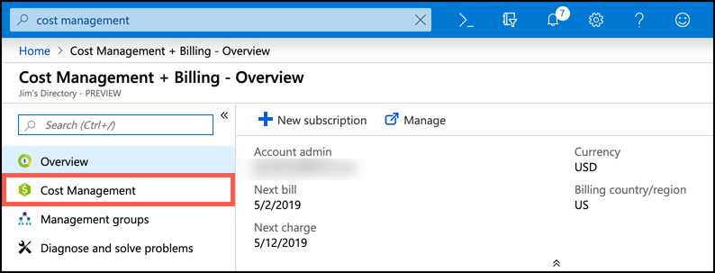
Azure Cost Management
Azure Cost Management is a tool in Azure that makes it easy to analyze your costs at a granular level. Cost Management allows you to create a budget for your Azure expenses, set configurable alerts so you’ll know if you are approaching a budgeted limit, and analyze your costs in detail.
To get started with Cost Management, open the Azure portal and search for Cost Management, and click on Cost Management + Billing.
Once Cost Management + Billing loads in the portal, click on Cost Management to access Cost Management.

Slide 29
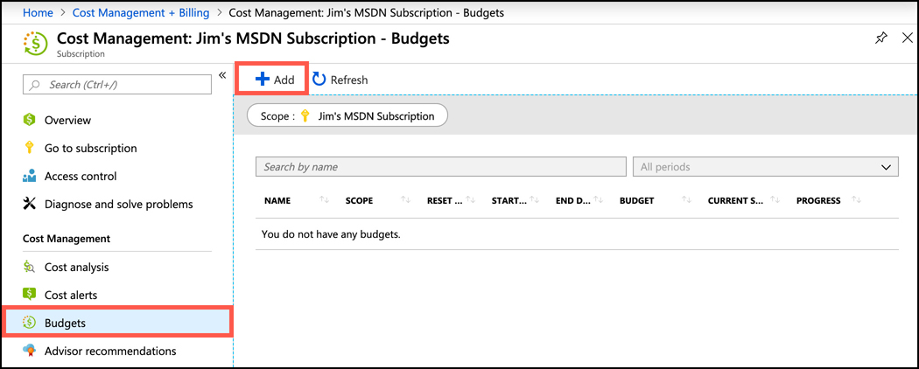
Azure Cost Management
To effectively monitor your costs, you should create a budget in Cost Management. Creating a budget isn’t required, but it will allow you to visualize your spending compared to your planned expenses.
Click on Budgets, and then click Add

Slide 30
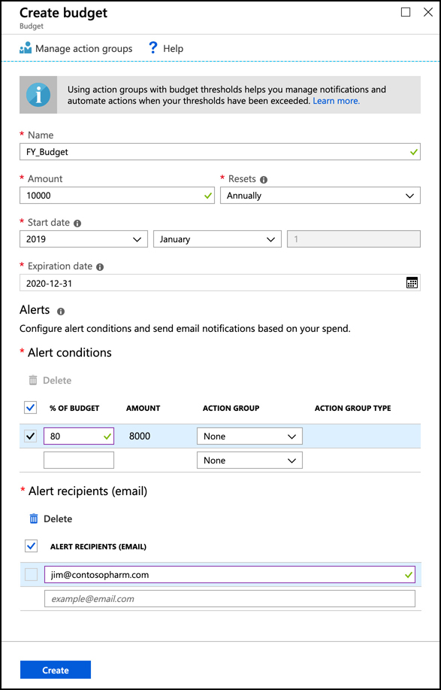
Azure Cost Management
Example: a $10,000 budget is being created for a fiscal year. An alert is being added when 80% of that budget has been reached, and Azure will send an email to jim@contosopharm.com if costs have reached $8,000

Slide 31
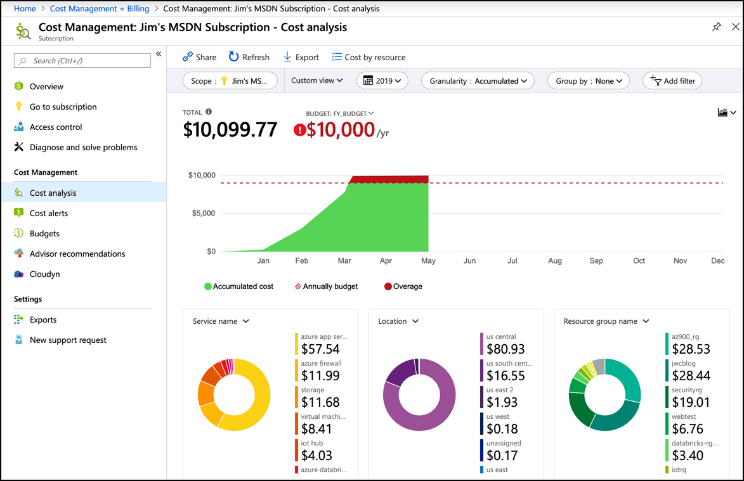
Azure Cost Management
After you create a budget, click on Cost Analysis to see how your spending compares to your budget.

